Slide 1

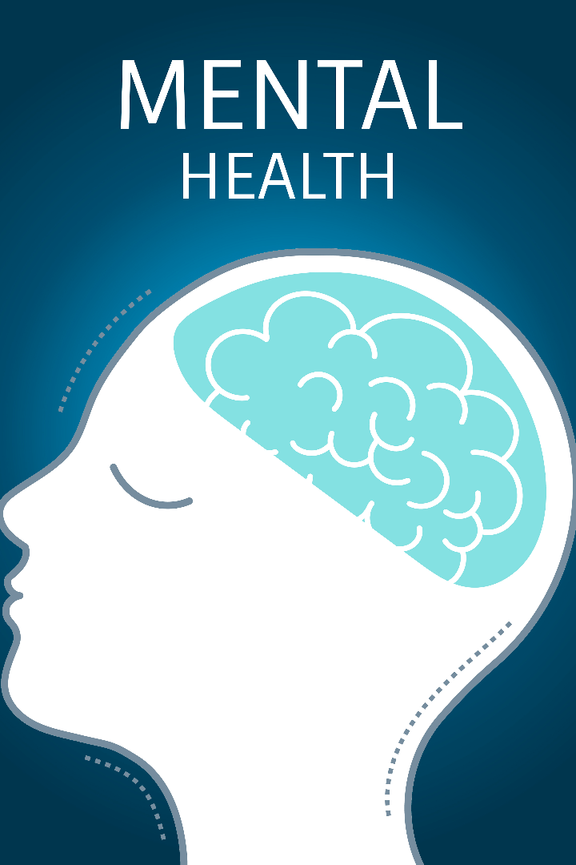
Creating the Serenity Space Project
Discover how we used data structures and algorithms in C++ and the SDL2 library to develop a powerful app focused on mental well-being. Let's explore its unique features!

Slide 2

App Overview: Serenity Space
Purpose of the Project
Serenity Space," a groundbreaking mental health app developed as our DSAA Project. Providing a variety of mental health activities, helping users manage stress and promote relaxation through a unique combination of user engagement, sophisticated data structures and graphics.
Description of the 5 Options
Explore different features: Journaling, Painting, Two Stress Relieving Games, and Piano Playing.

Slide 3

Data Structures and Algorithms in C++
Importance in Developing the App
Specific Structures and Algorithms Used
Benefits of Chosen Data Structures
By leveraging efficient data structures and algorithms, we ensure smooth execution and enhanced user experience.
We utilized linked lists, queues and stacks, binary trees, 2D arrays, sorting, tree backtracking algorithms to manage app data and optimize performance.
Linked lists, queues, and stacks optimize data management, while binary trees, 2D arrays, sorting, and backtracking algorithms enhance performance for a smoother user experience in Serenity Space.

Slide 4

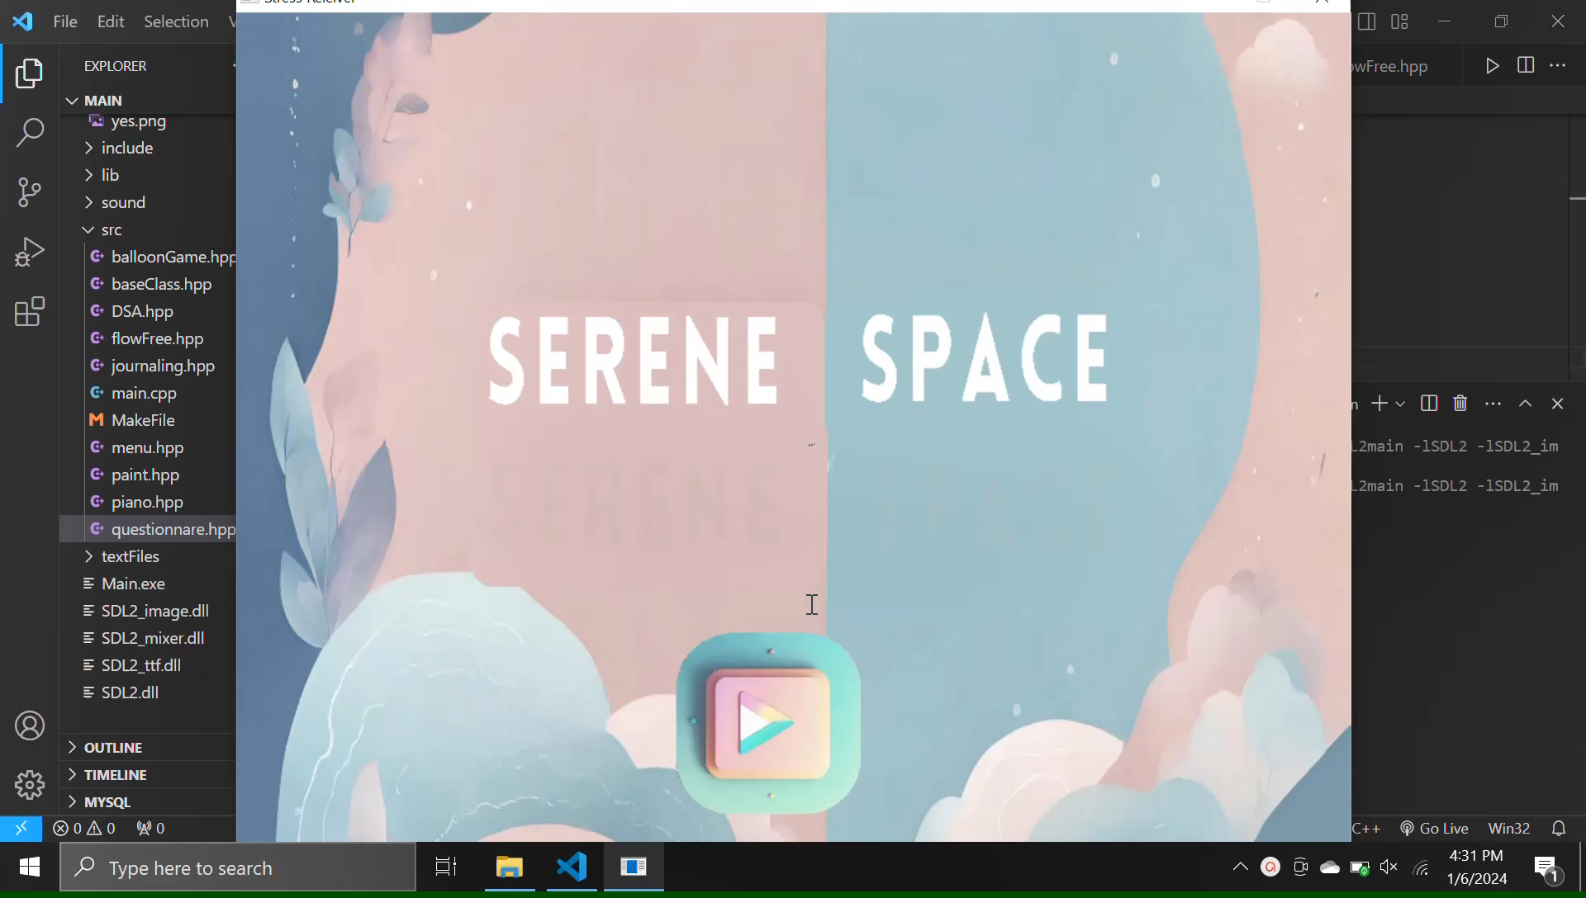
Exploring Serenity Space Features
Main Screen
Daily Check in
The Applications opens with a friendly chat, asking you about your day. Through a conversational binary tree, subsequent questions unfold based on your responses, creating an interactive and evolving experience tailored to your mood and needs

Slide 5
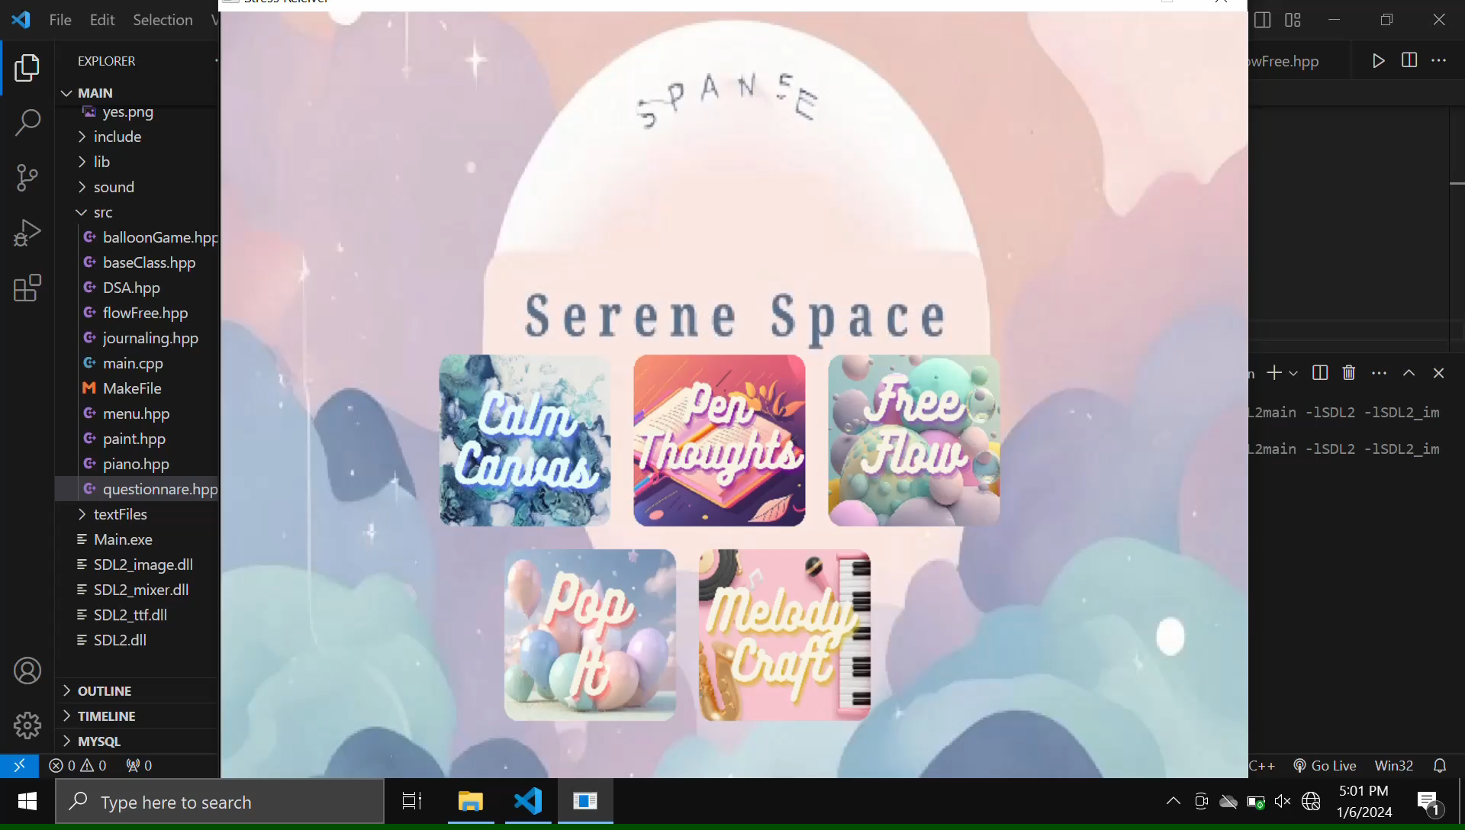
Exploring Serenity Space Features
Painting
Paint App enhances user interactions, undo/redo, and shape drawing through smart use of DSA like stacks and queues ensuring a responsive digital painting experience.

Slide 6
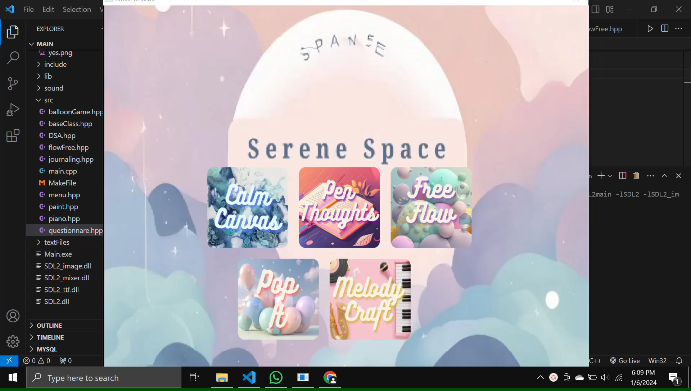
Exploring Serenity Space Features
Journaling
A digital sanctuary for users to express their thoughts and feelings. Our application utilizes Doubly linked lists to efficiently manage and organize journal entries, allowing users to reflect on their mental health journey

Slide 7

Exploring Serenity Space Features
Pop-It Stress-Relieving Game
In our stress-relieving game "Pop It," Linked Lists are ingeniously utilized, creating a dynamic and engaging experience for users to effectively relieve stress and anxiety.

Slide 8
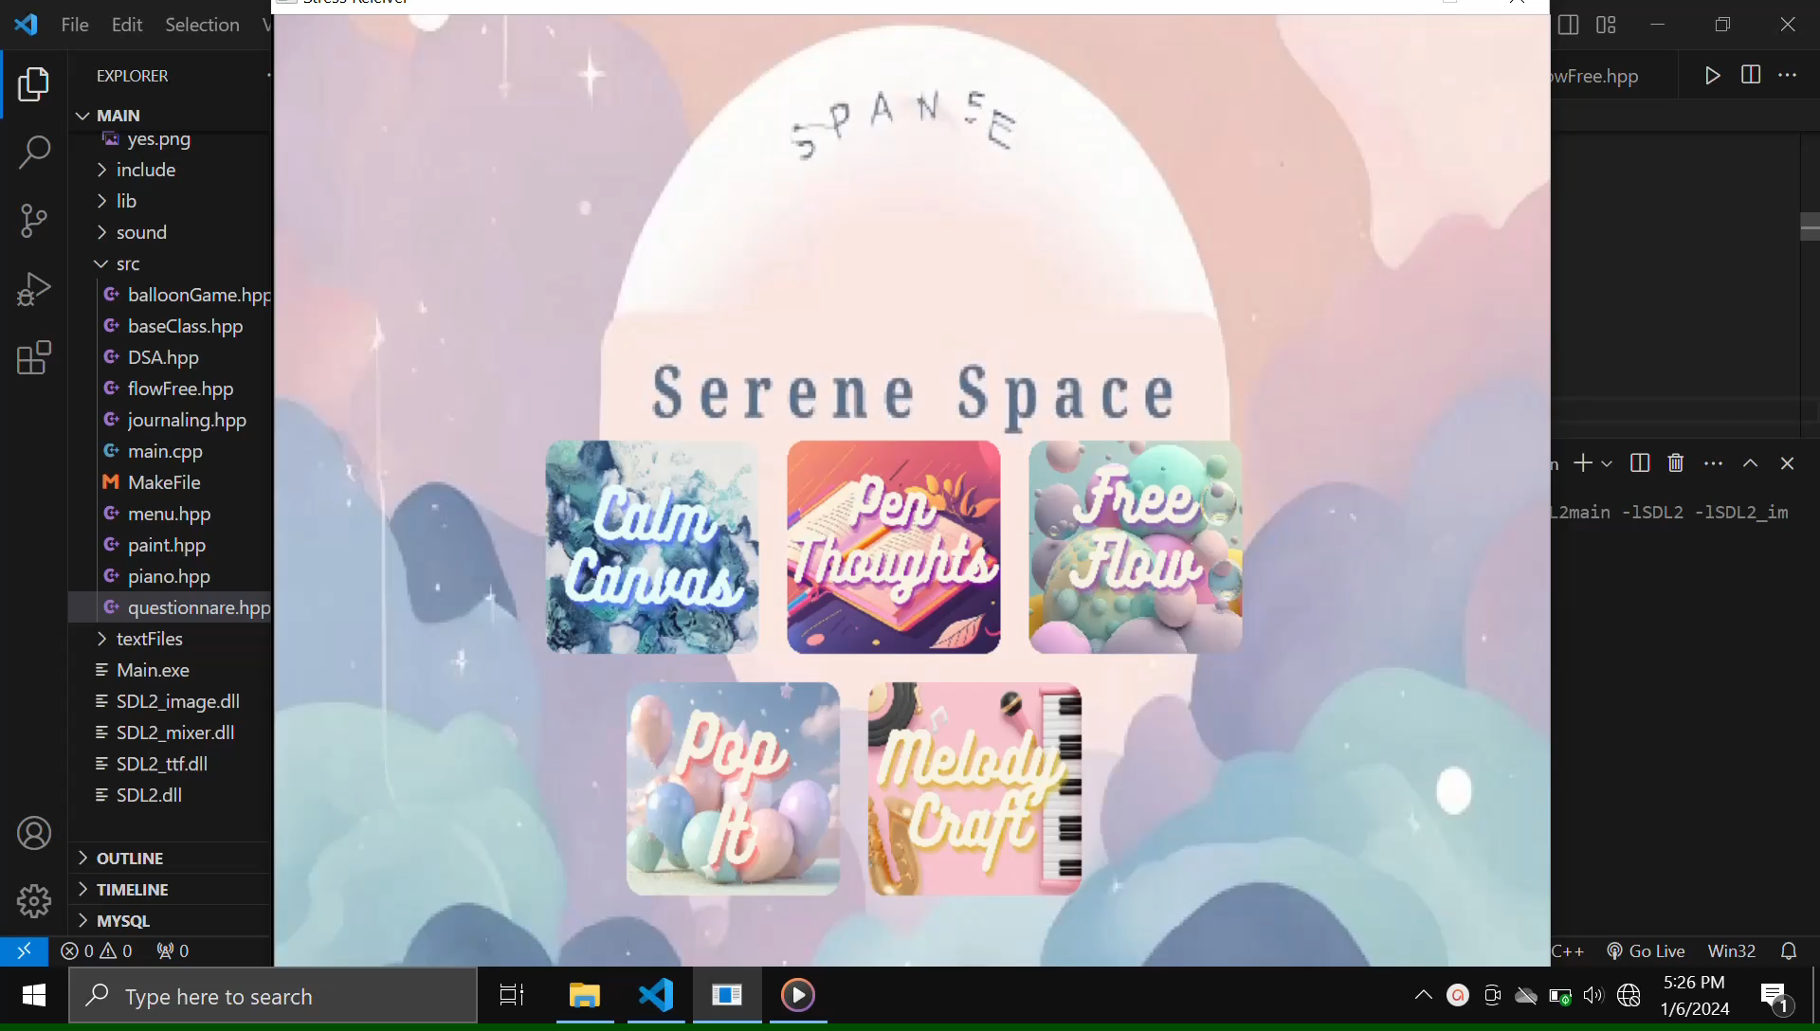
Exploring Serenity Space Features
Piano Playing
With our app's virtual piano, Circular Linked Lists are employed to create a seamless and continuous musical experience, enhancing the fluidity and harmony of the user's interaction.

Slide 9

Exploring Serenity Space Features
Free-Flow Relaxing Game
Designed using 2D arrays and backtracking algorithm to promote relaxation, our game allows users to play at their own pace with no time limits or pressure.

Slide 10
SDL2 Library
1
Introduction to SDL2 Library
2
Integration into the App
SDL2 is a powerful multimedia library that allowed us to incorporate graphics, sound, and interactive elements into our app.
By utilizing SDL2, we created engaging visuals, smooth animations, and immersive audio experiences for app users.

Slide 11
Benefits of the App
1
Mental Health Benefits for Users
2
Promoting Relaxation and Stress Relief
Our app fosters self-reflection, creativity, and relaxation, promoting overall mental well-being and stress reduction.
With activities like painting, playing the piano, and engaging games, users can unwind and find respite from daily stresses.

Slide 12
Conclusion
Recap of Main Points
Encouraging Audience to Explore the App
By leveraging advanced data structures and algorithms, we've crafted an application that not only adapts to individual needs but also provides a creative outlet for self-expression and stress relief. Through the power of C++ and the SDL2 library, we hope to make a positive impact on the mental health journey of our users.
We invite everyone to experience the app's unique features and embrace relaxation, creativity, and stress relief in their lives. We look forward to your feedback and engagement with Serenity Space!

Slide 13
Thank you
for your attention

